Slide 1






Welcome to the world of
Tic -Tac -Toe
START

Slide 2


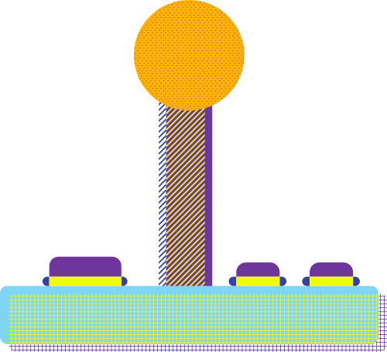


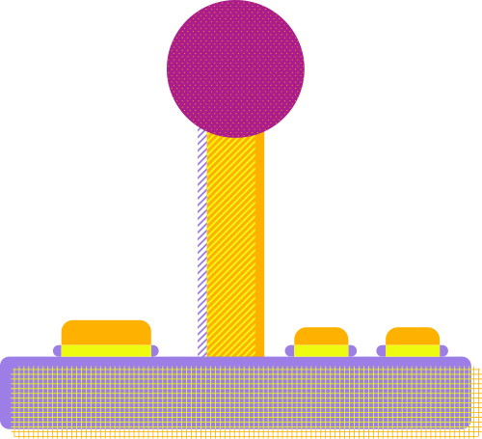
By one and only
Group : Dream Makers
From BCA Dept
Created by : Doyel Paul - 47
Srijanee Saha - 15
Amrita Sarkar - 25
Manisha Pandab - 55
Anik Das - 29

Slide 3
Introduction
about our game

Slide 4

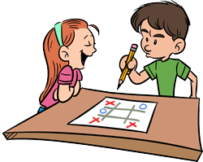
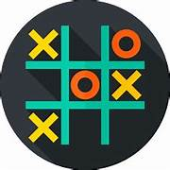
Originating as early as ancient Egypt, Tic Tac Toe, also known as Noughts ‘O’ and Crosses ‘X’ , has transcended cultures and centuries, remaining a staple in the realm of board games. Its simplicity belies the depth of strategy and critical thinking it offers, making it a beloved pastime enjoyed by people of all ages around the globe.
In this presentation, we will delve into the fascinating world of Tic Tac Toe not with pen and paper but with some fun codes with the help of our team.

Slide 5

Our Process
of creating the game

Slide 6
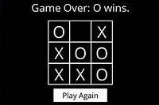
Steps involved!!
→
→
Create a board
Condition checking takes place
Take user input and start the game!!!

Slide 7

Detailed steps...
Create a board
Condition checking takes place
Take user input and start the game!!!
At first we make the board for the game by using user define function.
Then we take the names of our players.
For eg: First Player : ABC and Second Player: XYZ
The very next step is to check the condition.With the help of if-elif statement.
Here we check the winning condition. Which helps to decide who’s the winner.
Now we come to the last step of our program.
Here we take inputs from the user and then we can start the game!!!!!

Slide 8

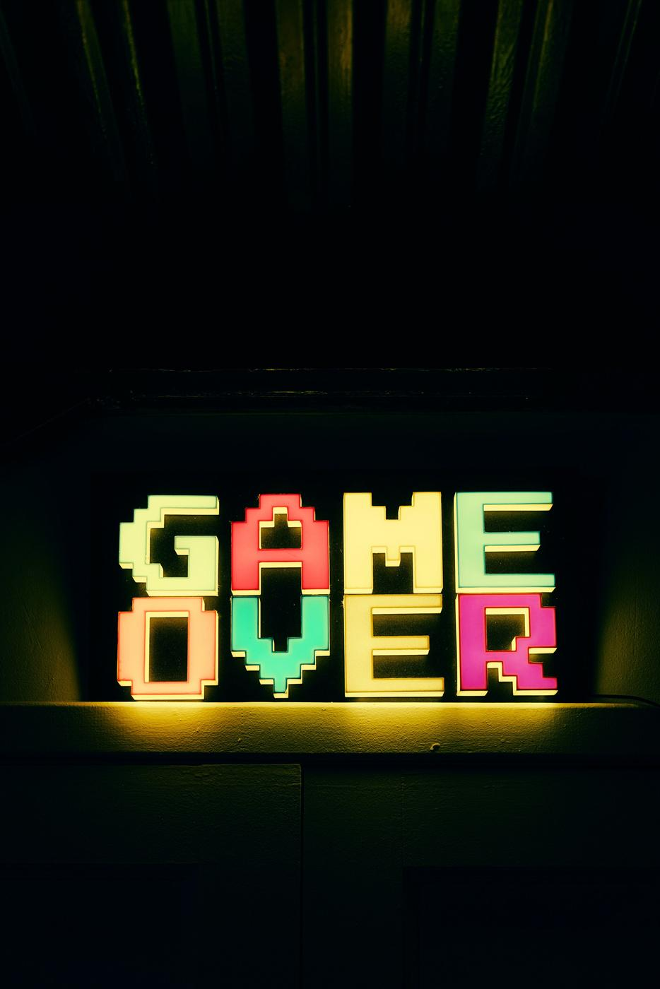
During this presentation we learnt how a simple game like Tic-Tac-Toe can help in the logical growth of a young mind by making them understand the concept of strategic and critical thinking. Whether played casually for fun or competitively to test one's skills, Tic Tac Toe remains a beloved classic that continues to entertain people of all ages.
Thank you!

